Slide 1
C# Tutorial - First lecture
Covering:
OOP, Namespaces, Loops, Arrays, Variables, Math (Introduction), Operators, Ternary Opearator, Switch and Break
Presentation by: Luka Zdravkovic
LinkedIn: linkedin.com/in/luka-zdravkovic

Slide 2
OOP vs Procedural Programming
OOP stands for Object-Oriented Programming.
Procedural programming is about writing procedures or methods that perform operations on the data, while object-oriented programming is about creating objects that contain both data and methods.
Why OOP?
OOP is faster and easier to execute
OOP provides a clear structure for the programs
OOP helps to keep the C# code DRY "Don't Repeat Yourself",
and makes the code easier to maintain, modify and debug
OOP makes it possible to create full reusable applications
with less code and shorter development time

Slide 3
Example of a ‘main’ method in C# (OOP) and C (Procedural):
C# (OOP in a Program.cs file)
using System;
class Program {
// Main Method
static public void Main(String[] args)
{
Console.WriteLine("Main Method");
}
}
C (Procedural in a main.c file)
#include <stdio.h>
int main() {
// printf() displays the string
printf("Hello, World!");
return 0;
}

Slide 4
Namespaces
Keywords:
using
To allow the use of types in a namespace so that you do not have to qualify the use of a type in that namespace:
Code example: using System.Text;
namespace
Declaring your own namespaces can help you control the scope of class and method names in larger programming projects. Use the namespace keyword to declare a namespace, as in the following example:
Code example: namespace CodeTesting

Slide 5
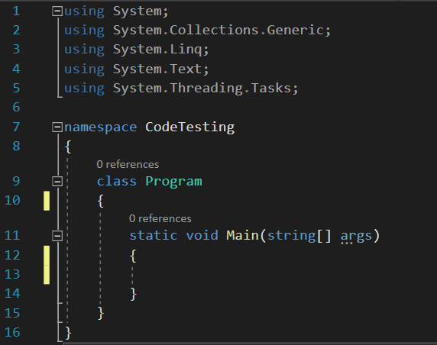
Namespaces – Console App Example

Slide 6
Loops
The three ‘basic’ loops are:
For (When you know exactly how many times you want to loop through a block of code)
While (Can execute a block of code as long as a specified condition is reached)
Do while (Similar to the while loop, used when you want to execute a block of code and then continue executing it only if a condition is met).

Slide 7
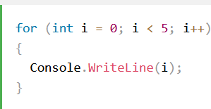
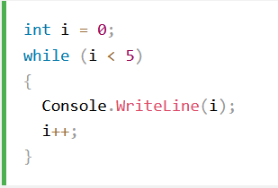
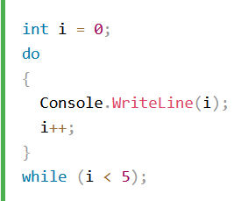
Loop code examples:
For loop:
While loop:
Do While loop:

Slide 8
Arrays
Arrays are used to store multiple values in a single variable, instead of declaring separate variables for each value.
To declare an array, define the variable type with square brackets: []
Code example of declaring an array:
string[] cars;
Code example for inserting values to declared array:
cars = new string[] { “Volvo”, “Mazda”, “BMW”, “Ford” };

Slide 9
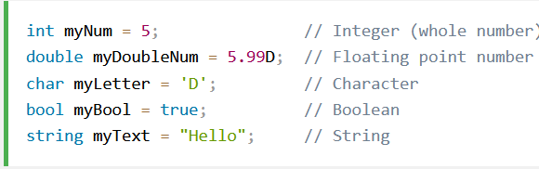
Variables
Variables are containers for storing data values.
int - stores integers (whole numbers), without decimals, such as 123 or -123
double - stores floating point numbers, with decimals, such as 19.99 or -19.99
char - stores single characters, such as 'a' or 'B'. Char values are surrounded by single quotes
string - stores text, such as "Hello World". String values are surrounded by double quotes
bool - stores values with two states: true or false
Code example of every variable listed:

Slide 10
Math in C#
Why is math important in programming?
The (short) answer:
“No, mathematics is not necessary for programming".
However, as other people have suggested, I believe there is a correlation between understanding mathematics and being able to "think algorithmically".
That is, to be able to think abstractly about quantity, processes, relationships and proof.
The longer and ‘better’ answer can be found on this thread:
https://stackoverflow.com/questions/157354/is-mathematics-necessary-for-programming

Slide 11
Math in C# - Methods
The C# Math class has many methods that allows you to perform mathematical tasks on numbers.
Some popular methods can be found here:
https://www.w3schools.com/cs/cs_math.asp

Slide 12
Operators
Operators are used to perform operations on variables and values.
There are four groups of operators in C#:
Arithmetic Operators
Assignment Operators
Comparison Operators
Logical Operators

Slide 13
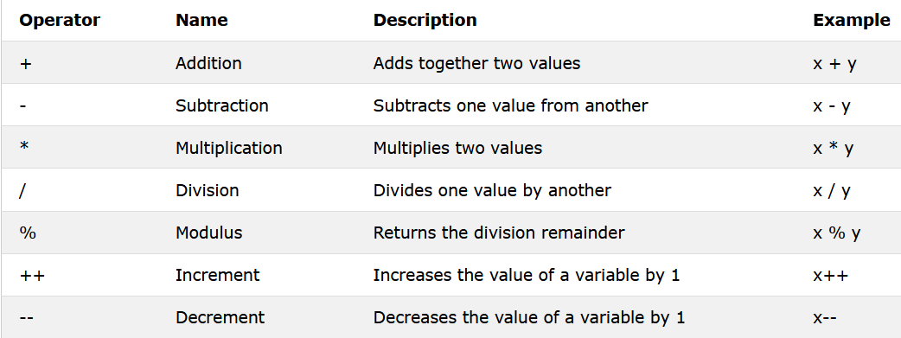
Arithmetic operators
Arithmetic operators are used to perform common mathematical operations:

Slide 14
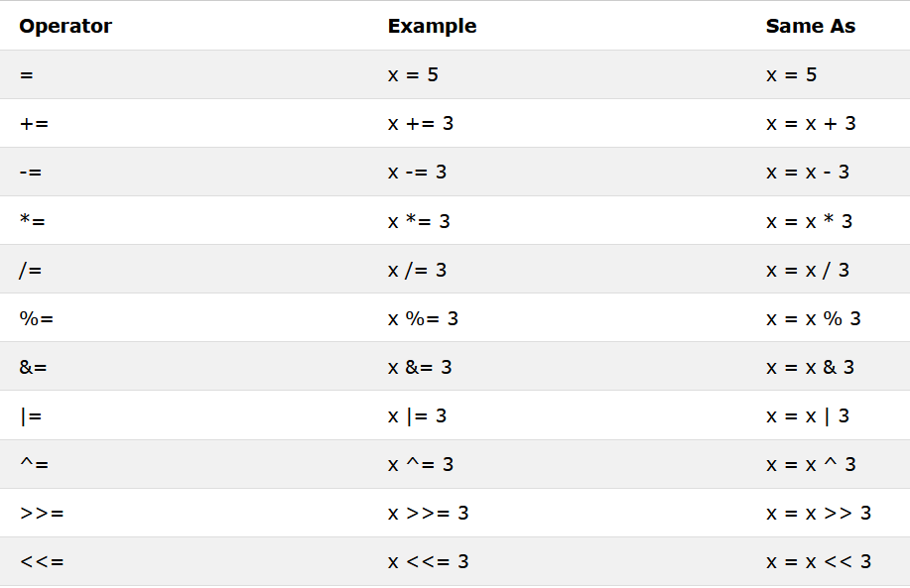
Assignment Operators
Assignment operators are used to assign values to variables.

Slide 15
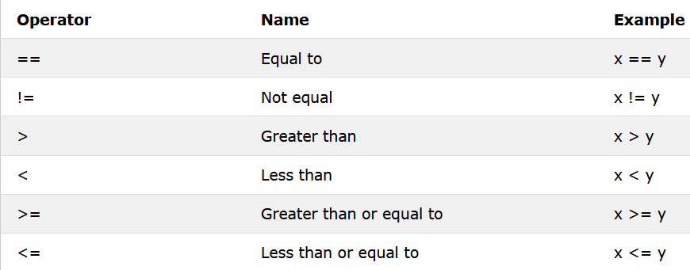
Comparison Operators
Comparison operators are used to compare two values:

Slide 16
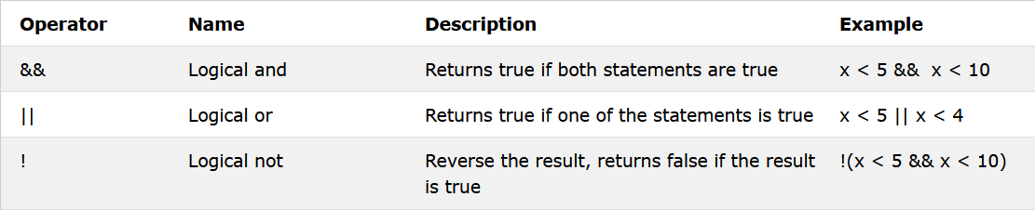
Logical Operators
Logical operators are used to determine the logic between variables or values:

Slide 17
Short-hand If...Else (Ternary Operator)
There is also a short-hand if else, which is known as the ternary operator because it consists of three operands.
It can be used to replace multiple lines of code with a single line. It is often used to replace simple if else statements.
The syntax:
variable = (condition) ? expressionTrue : expressionFalse;

Slide 18
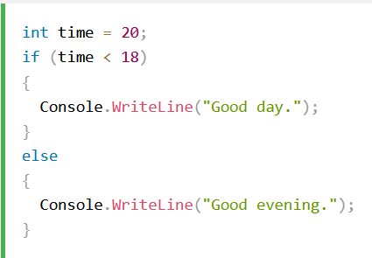
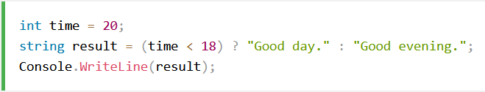
Example of a ternary operator
Using if…else:
Same result using ternary operator:

Slide 19
Switch / Break
Use the switch statement to select one of many code blocks to be executed.
The break statement is used to exit a block of code, which means that any code below the break statement will not further execute.

Slide 20
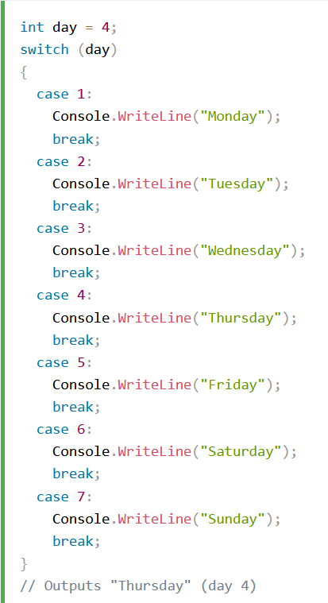
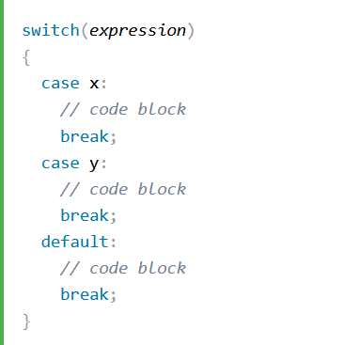
Switch / Break – syntax and example
Syntax:
Example:

Slide 21
HOMEWORK ASSIGNMENT
10 Questions
5 Exercises

Slide 22
Question 1:
What is the difference between object oriented programming and procedural programming?

Slide 23
Question 2:
What does the term ‘DRY’ mean in object oriented programming?

Slide 24
Question 3:
What are the keywords “using” and “namespace” meant to achieve?

Slide 25
Question 4:
What are the 3 commonly used loops in programming?
Describe them by their purpose.

Slide 26
Question 5:
What is an array in C#?

Slide 27
Question 6:
Is the following code example correct? Explain your statement.
string[] strArr = [] { “Miles Davis”, “John Coltrain”, “Becky Silvious” };

Slide 28
Question 7:
Is the following code example correct? Explain your statement.
int[] numArr;
numArr = new int[];

Slide 29
Question 8:
Is the following code example correct? If not, explain why.
double Pi1 = 3.14;
double Pi2 = 3.1415926535897932384626D;
float longPi = 3.1415926535897932384626433832795028841971693993751058209749445923078f;
Console.WriteLine(“Pi1 is: “ + Pi1);
Console.WriteLine(“Pi2 is: “ + Pi2);
Console.WriteLine(“longPi is:” + longPi);
// Used for stopping the console from automatically closing.
Console.ReadLine();

Slide 30
Question 9:
A simple main method is given below.
What is will be shown on the console after the code executes?
Describe your explanation.
void main()
{
int x = 5;
int i;
for(i = 0; i < 50; i*=2)
Console.WriteLine(x);
// Used for stopping the console from automatically closing.
Console.ReadLine();
}

Slide 31
Question 10:
A simple main method is given below.
What is will be shown on the console after the code executes?
Describe your explanation.
void main()
{
int i;
for (i = -5; i <= 6; ++i)
Console.WriteLine(i);
// Used for stopping the console from automatically closing.
Console.ReadLine();
}

Slide 32
Exercise 1:
Given a year, report if it is a leap year.
Input example 1: 2000
Output: The year 2000 is a leap year
Input example 2: 2002
Output: The year 2002 is not a leap year

Slide 33
Exercise 2:
Given a date in the following format: “dd.mm.yyyy.”, extract the day, month and year. If the date is incorrect, display a proper message to the user.
Input example 1: 13.3.2021.
Output: The entered date is correct: March 13, 2021
Input example 2: 30.2.2020.
Output: The entered date is not a valid input.

Slide 34
Exercise 3:
Given an age in seconds, calculate how old someone is.
Input example:
662695445
Output: This person is 21 years old.
Note: the program should inform the user if the person has more than 100 years with an appropriate message.

Slide 35
Exercise 4:
Given an age in seconds, calculate how old someone is in terms of a given planet's solar years.
Write an appropriate message for every planet in the output.

Slide 36
Exercise 5:
Tally the results of a small football competition.

Slide 37
Thank you for your attention.
Luka Zdravkovic

